Slide 1



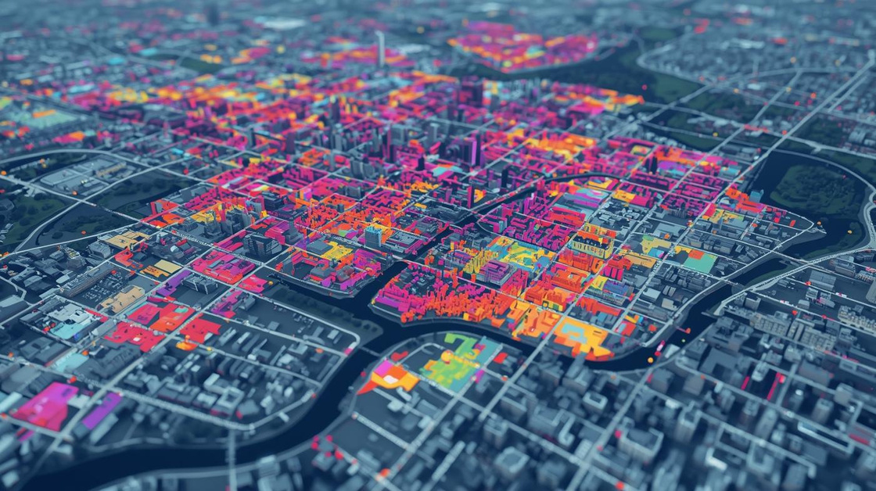
International Conference on Sustainable Communication Networks and Application (ICSCN 2025)
Crime Data Prediction Using Machine Learning
Paper ID: ICSCN-144
Transforming reactive policing into proactive crime prevention through advanced analytics and predictive modeling
Presented by
V.V.A.S Lakshmi
Maddi Chidananda Dedeepya
ThokaAshaGayathri
UbbathotiVenkateswarlu
Narasaraopeta Engineering College (Autonomous)

Slide 2
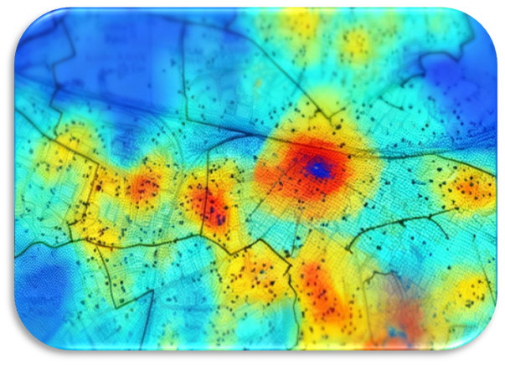

Introduction
Project Overview
This project develops a machine learning-based crime prediction system that analyzes historical crime data to forecast future crime patterns, enabling proactive law enforcement and community safety measures through data-driven insights.
Community Safety
Transforming reactive policing into proactive prevention through predictive analytics and intelligent resource allocation.
AI-Powered Insights
Leveraging advanced ML algorithms to uncover hidden patterns and correlations in complex crime datasets.

Slide 3




Problem Statement
Current Challenges
Data Complexity
Traditional crime analysis is reactive, relying on manual records and statistical summaries that fail to predict future trends or identify hidden patterns.
Crime data is multi-dimensional, influenced by unemployment, literacy, poverty, population density, and urbanization factors.
Policy Limitations
Resource Allocation
Limited insights for policymakers to understand socio-economic factors contributing to crimes and plan interventions.
Inefficient personnel deployment due to inability to anticipate crime hotspots and temporal patterns in advance.

Slide 4




Objectives
Data Collection & Preprocessing
Feature Analysis & Selection
Data Collection & Preprocessing
Gather crime datasets from NCRB and repositories, clean and transform data to handle missing values and inconsistencies.
Identify key socio-economic factors influencing crime using statistical and correlation analysis for optimal feature selection.
Model Development & Training
Performance Evaluation
Apply ML algorithms including Random Forest, XGBoost, and Time Series models to predict future crime trends accurately.
Evaluate models using Accuracy, Precision, Recall, RMSE, and R² Score metrics to determine the most effective approach.

Slide 5
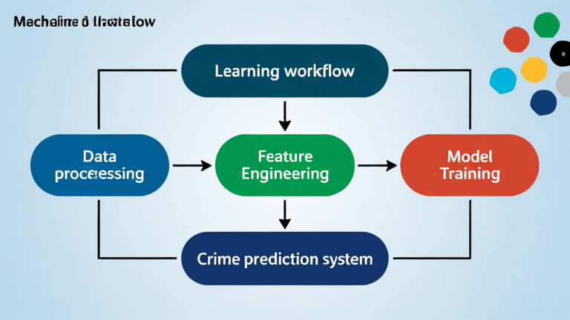



Proposed Methodology Overview
Feature Engineering
Create temporal, spatial, and socio-economic features including crime density, unemployment rates, and seasonal patterns.
Model Training
Train ensemble models using Random Forest, XGBoost, LightGBM networks with cross-validation and hyperparameter tuning.
Data Ingestion
Collect crime records, socio-economic data, and demographic indicators from multiple sources including UNODC datasets.

Slide 6


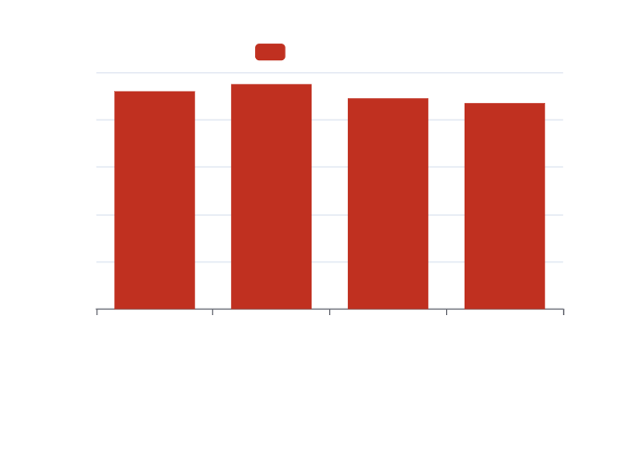

Results
Best Performing Model
XGBoost achieved 95% accuracy with superior precision and recall metrics for crime type prediction.
Key Insights
Ensemble methods outperformed individual algorithms, with spatial-temporal features proving most predictive.

Slide 7



Performance Analysis
High accuracy
Reduced false positives
Spatial hotspot prediction
Achieved 95% prediction accuracy across crime types.
Lowered false positive rate by 23% effectively.
Achieved 87% accuracy in identifying high-risk areas.

Slide 8
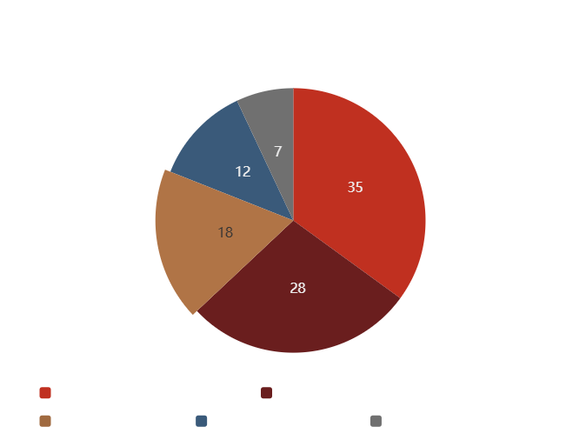
Critical Predictive Factors
SHAP Analysis Insights (Key Predictive Factors)
Socio-Economic Indicators (35%)
Strongest influence on crime prediction
Includes factors like unemployment rate, literacy level, and income level
Reflects the social and economic conditions driving criminal activity
Historical Crime Patterns (28%)
Past crime incidents and trends serve as major predictors
Helps identify recurring hotspots and time-based crime clusters
Spatial Features (18%)
Geographical factors like distance to police stations and neighborhood characteristics
Influence crime likelihood and model accuracy
Temporal Patterns (Additional Insight)
Seasonality and time-of-day effects contribute to predictive precision
Enable more targeted interventions and optimized police deployment

Slide 9

Conclusion
This project transforms crime prevention from reactive response to proactive intervention, demonstrating how machine learning can create safer communities through data-driven insights and predictive analytics. Our 95% accuracy rate proves that AI-powered crime prediction is not just theoretical—it's a practical tool for law enforcement agencies. The integration of socio-economic factors with historical crime data provides unprecedented accuracy in forecasting criminal activity patterns.

Slide 10

Thank You For Your Attention

